Slide 1
Home Fixer
-Make Life Easy

Slide 2

Introduction
Project Name Home Fixer
Group id 64
Viral Chudasama 3094
Dipak Prajapati 3136
Maulik Parmar 3209
Internal Guide Nidhi Jain

Slide 3
Project Profile
Project Definition :
In this Application Customers can use the
services related to home and choose particular
services using this Application.

Slide 4
Project Profile
Current System :
WWW.HOMEJOY.COM
Proposed System :
Proposed system is based on the internet so its time saving.
Lots of home services are easily finding.
Numbers of services are there.
Numbers of service provider for particular services.

Slide 5
System Requirement and Specification
Front end :
Android Studio
Back end :
SQL Server
Hardware specification :
Android Phone with minimum version 4.4.4 Kitkat.
(covers 96.2 % of the world wide android phone users).
Internet connection.

Slide 6
System Design
Diagrams
Use Case Diagram
Class Diagram
Sequence Diagram
Activity Diagram

Slide 7
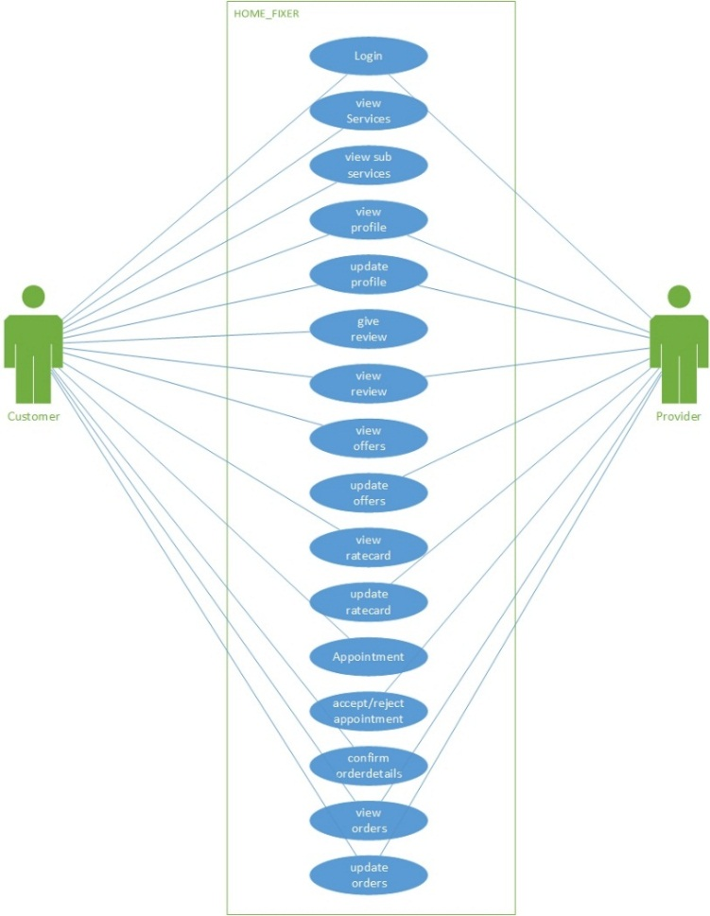
Use case Diagram

Slide 8
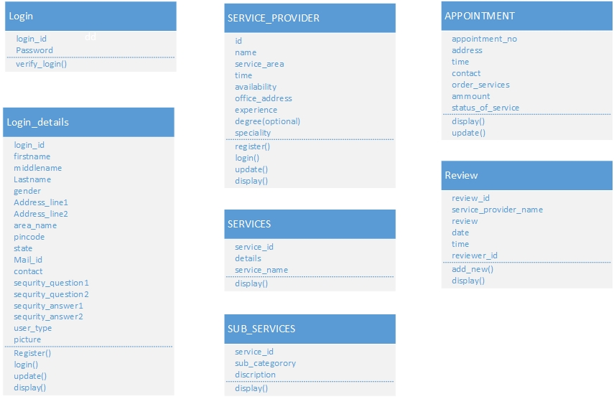
Class Diagram

Slide 9
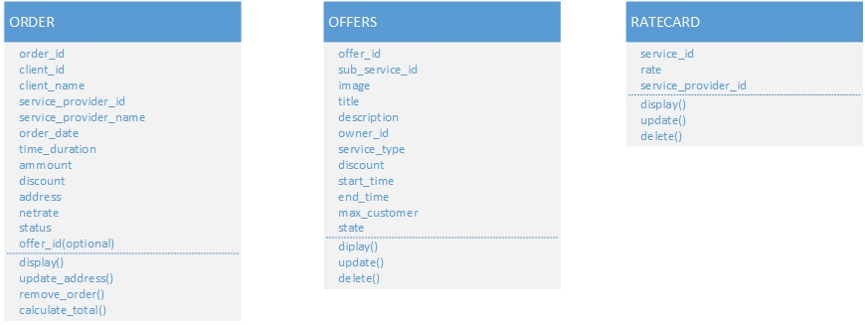
Class Diagram cont..

Slide 10
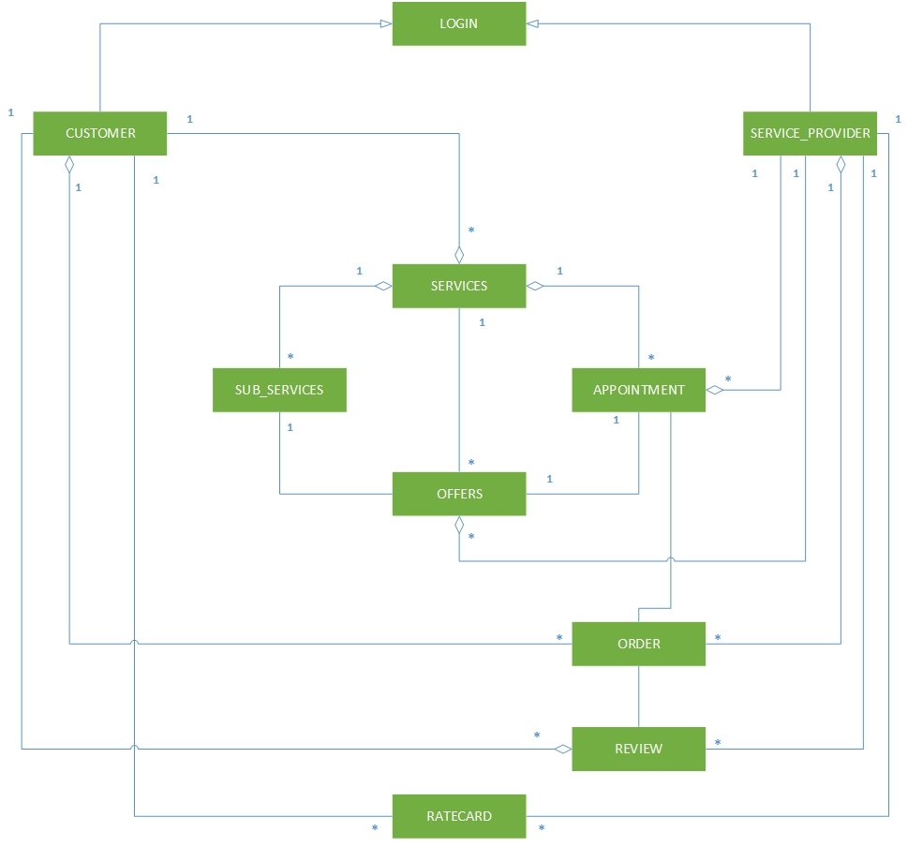
Class Diagram cont..

Slide 11
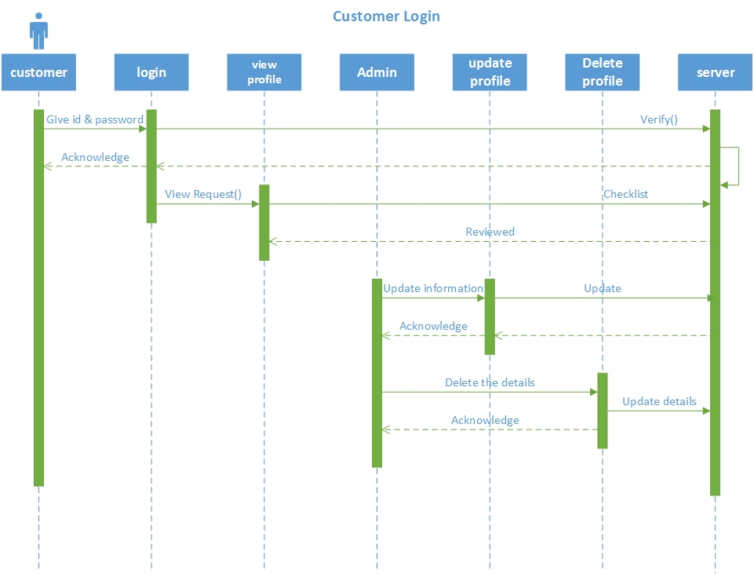
Sequence Diagram

Slide 12
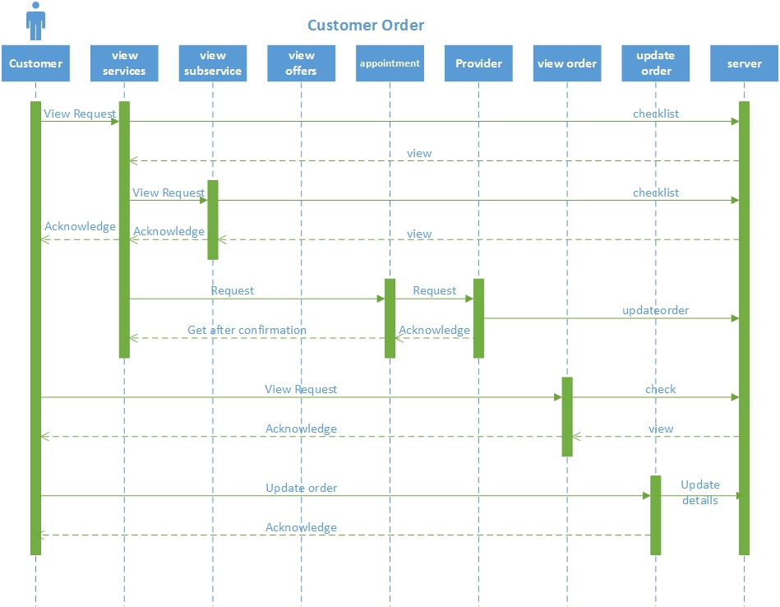
Sequence Diagram cont..

Slide 13
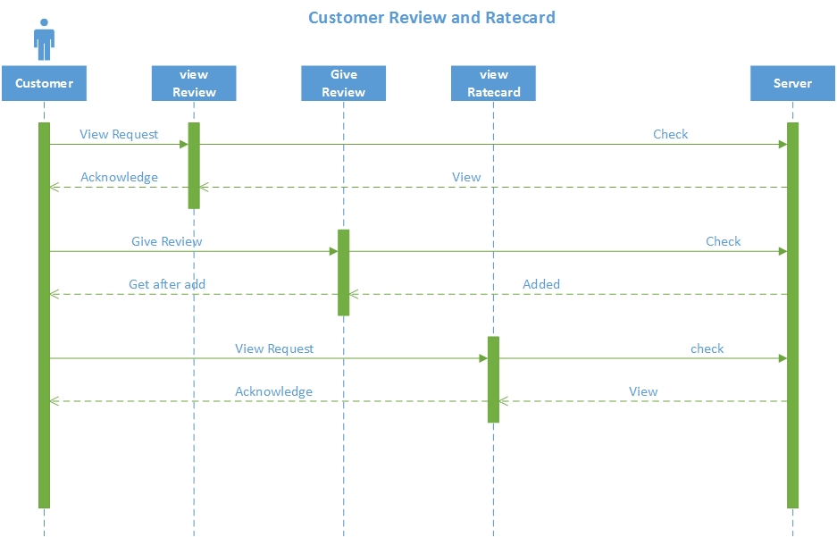
Sequence Diagram cont..

Slide 14
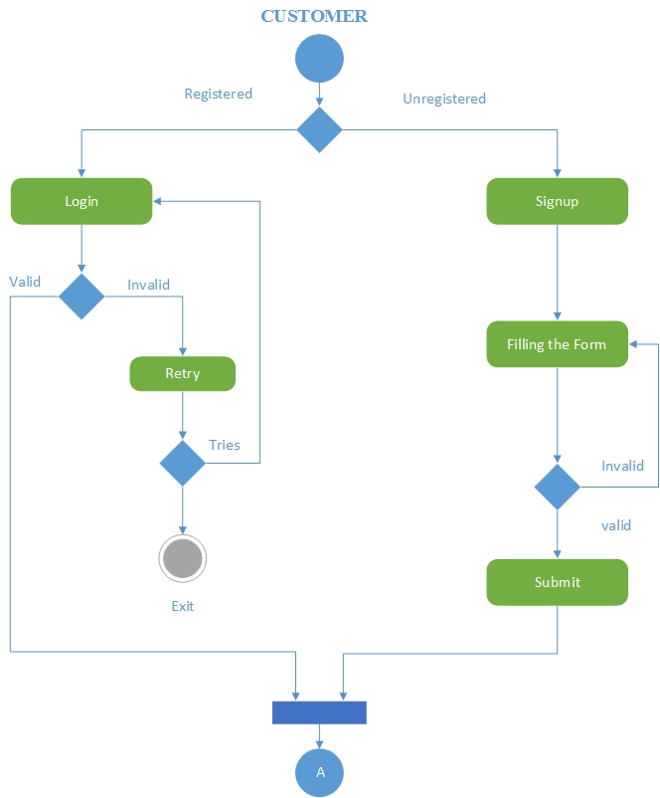
Activity Diagram

Slide 15
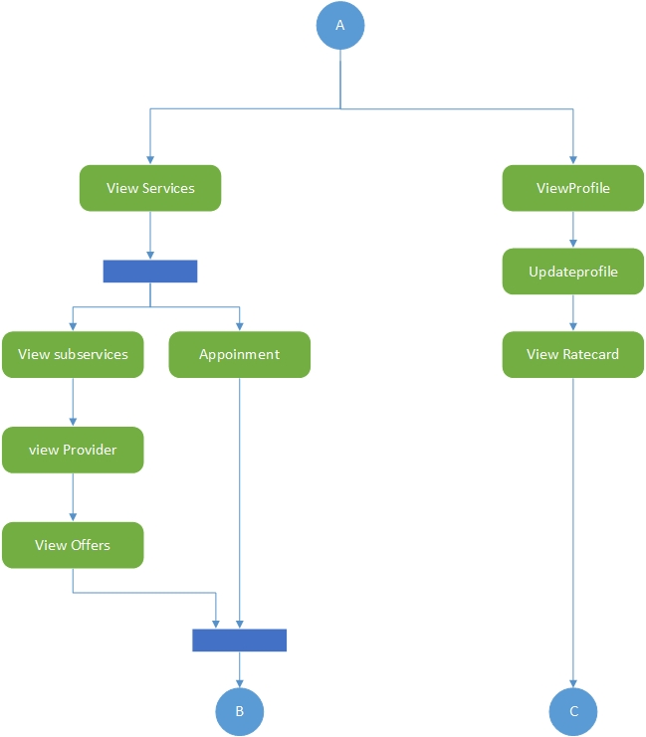
Activity Diagram cont..

Slide 16
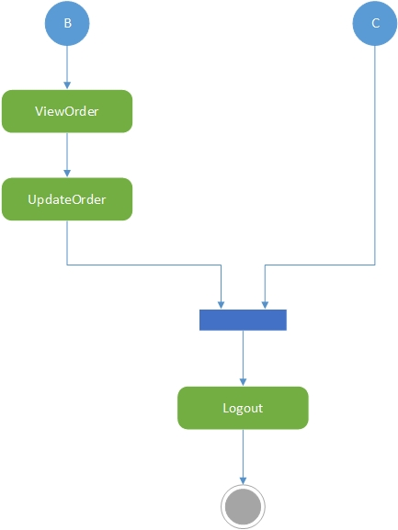
Activity Diagram cont..

Slide 17
Data Dictionary
TablePdf

Slide 18
Input – Output Design

Slide 19
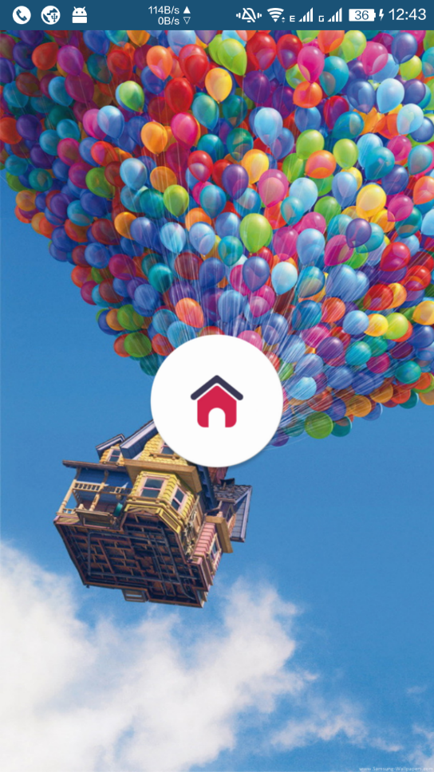
Home Fixer

Slide 20
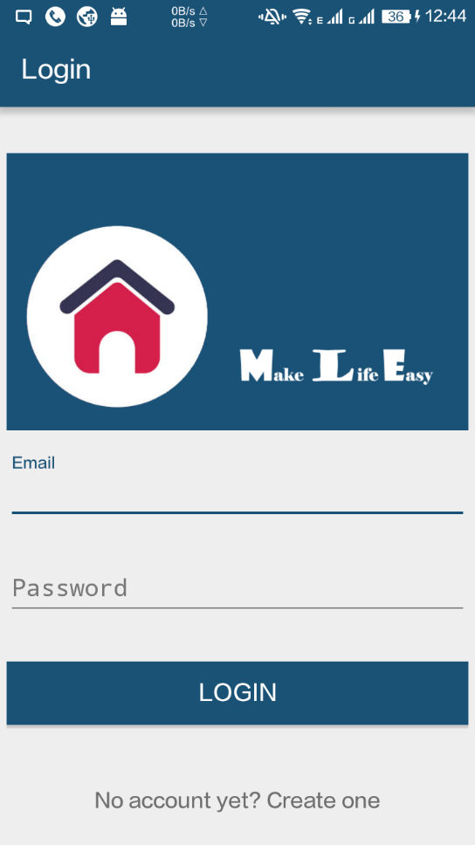
Login

Slide 21
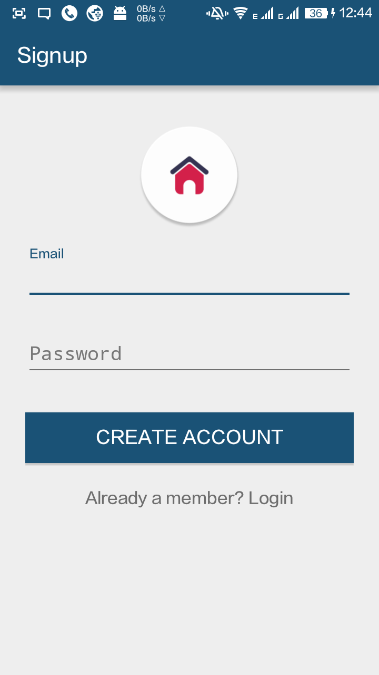
Signup

Slide 22
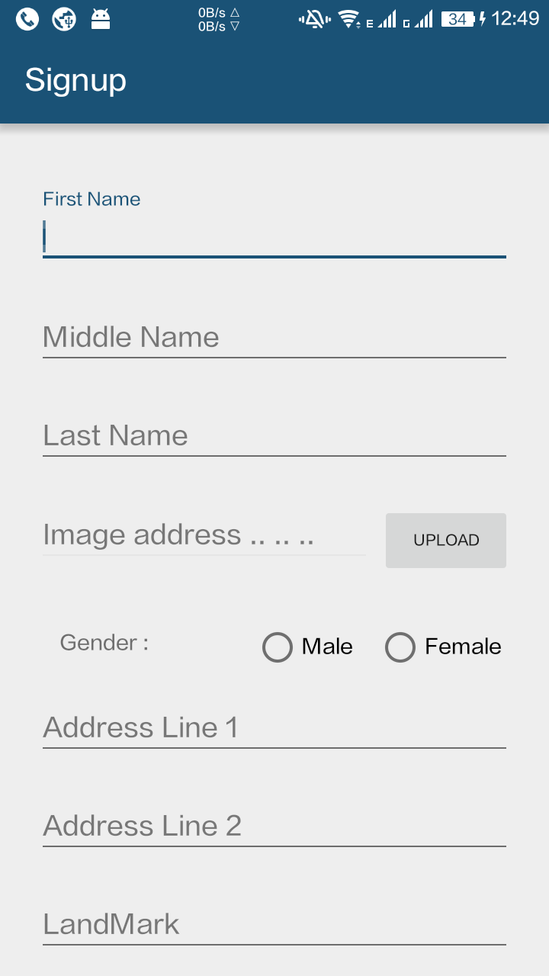
Signup cont..

Slide 23
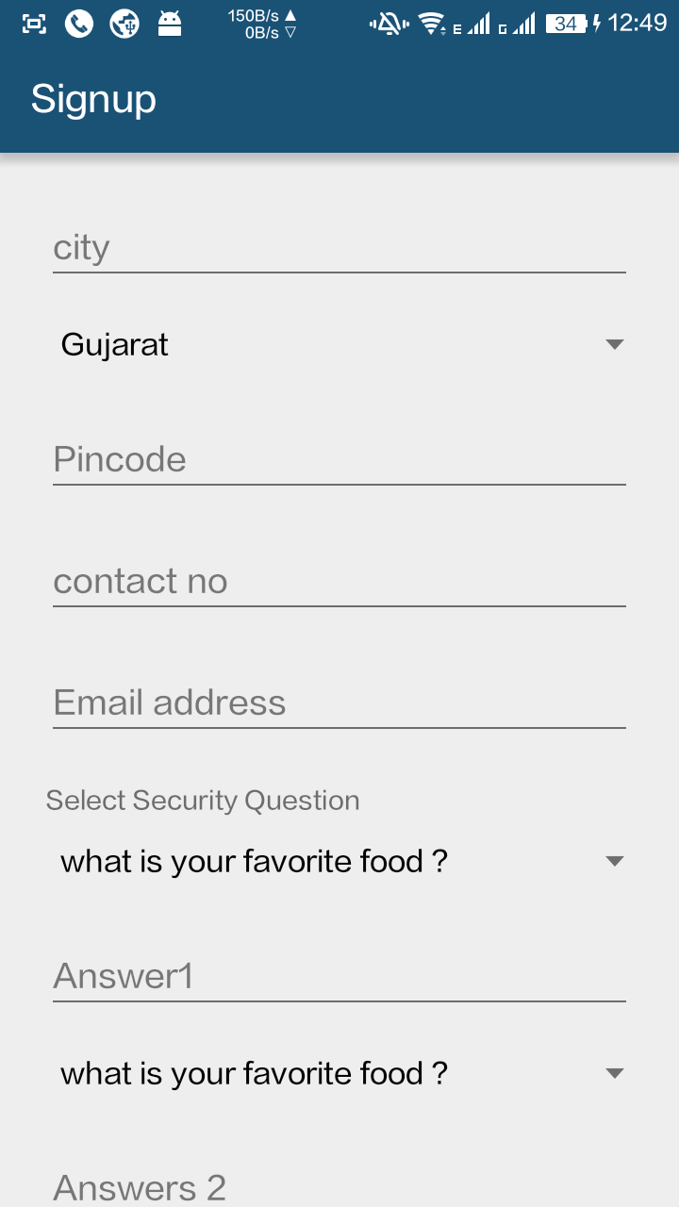
Signup cont..

Slide 24
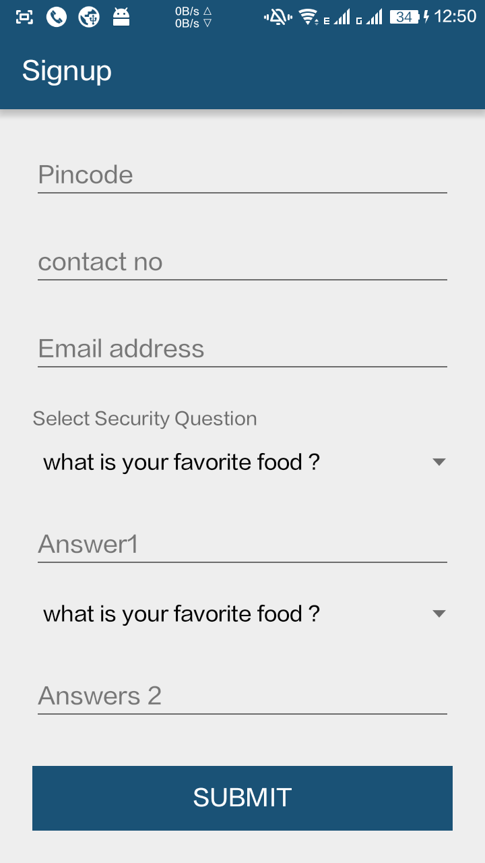
Signup cont..

Slide 25
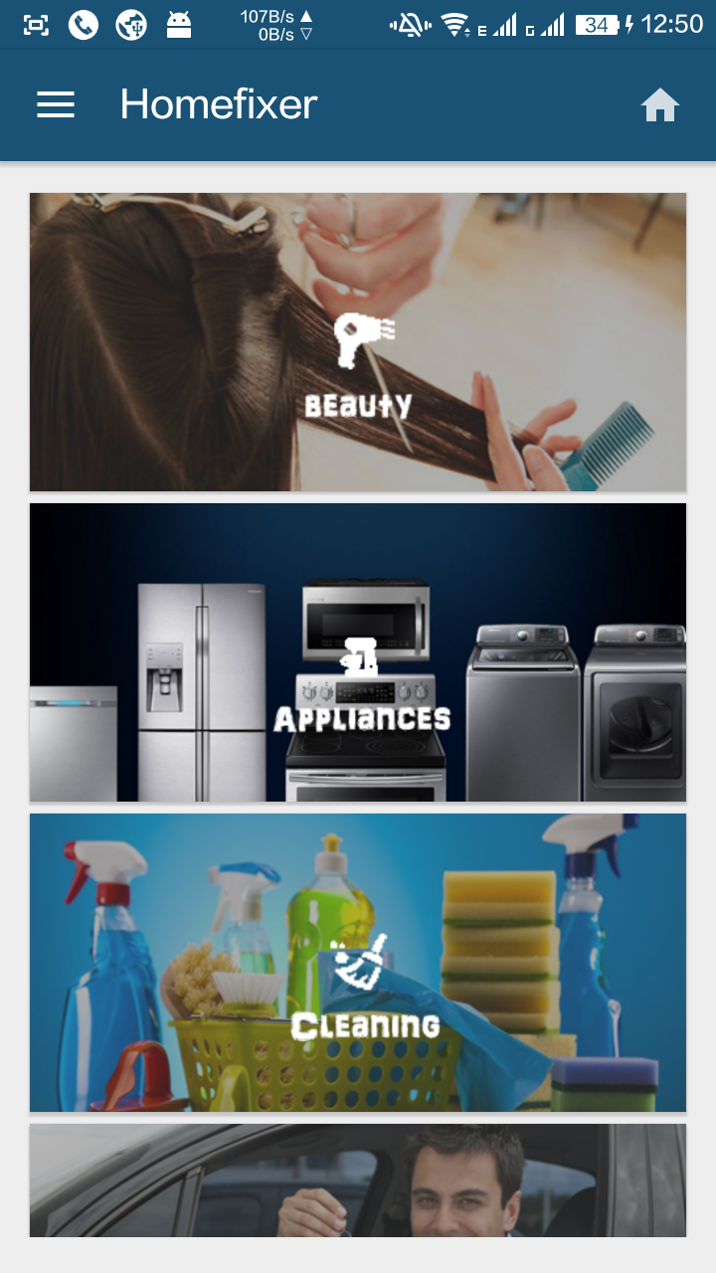
Services

Slide 26
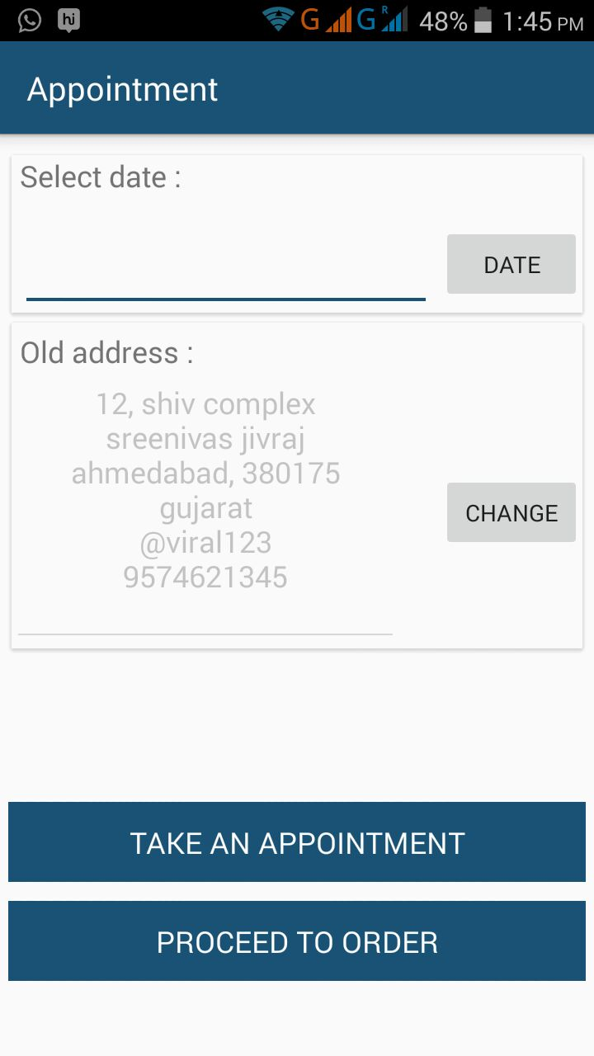
Appointment

Slide 27
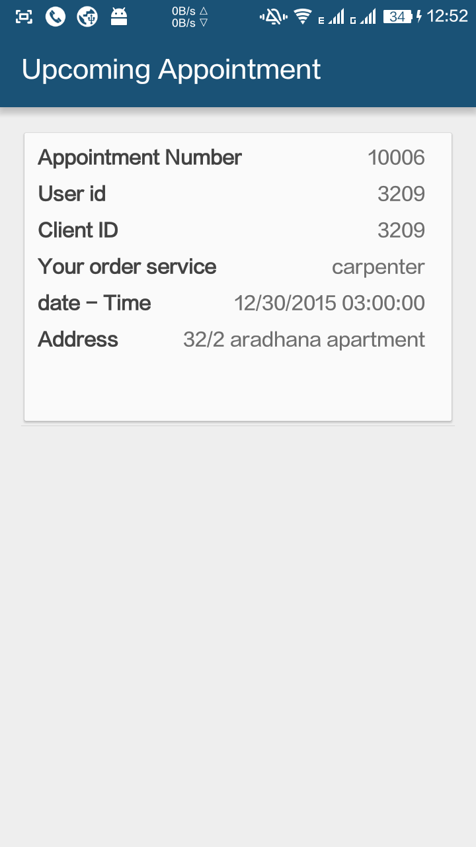
Upcoming Appointment

Slide 28
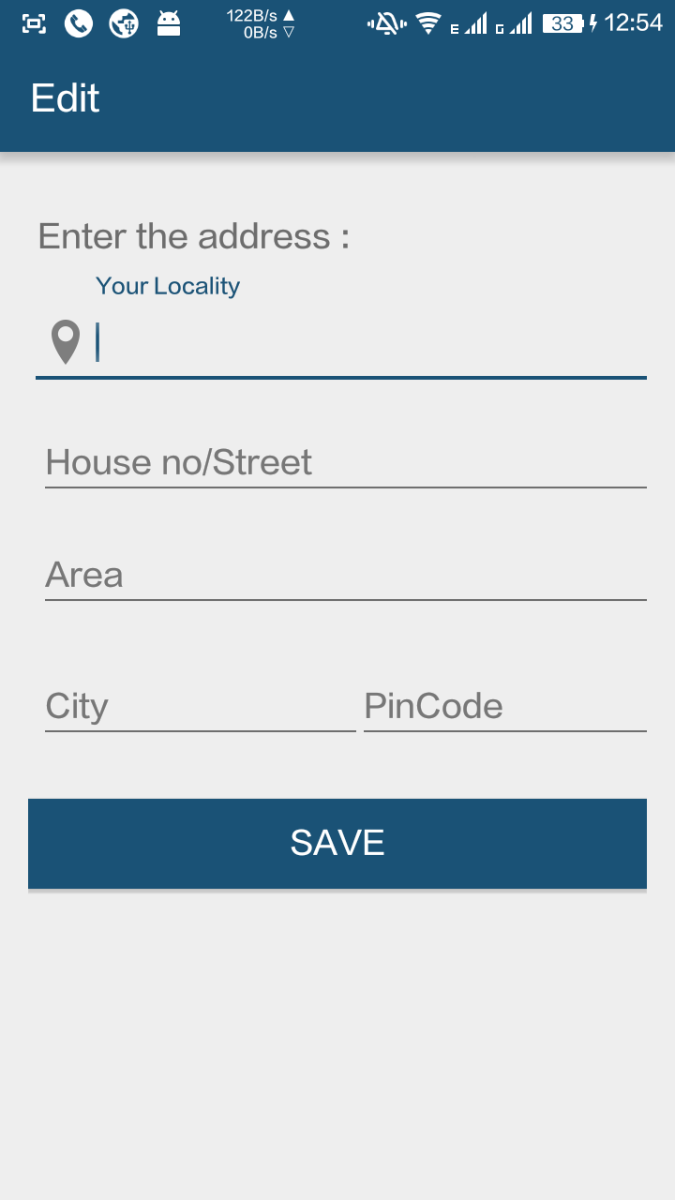
Edit Address

Slide 29
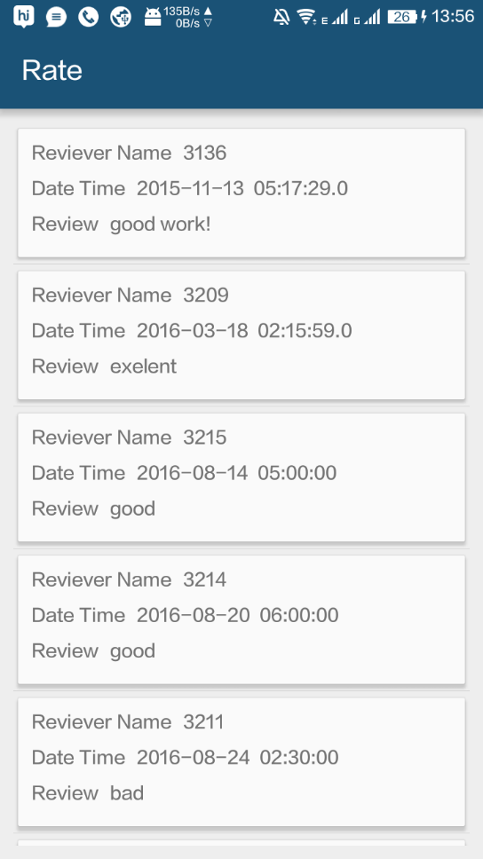
Rate

Slide 30
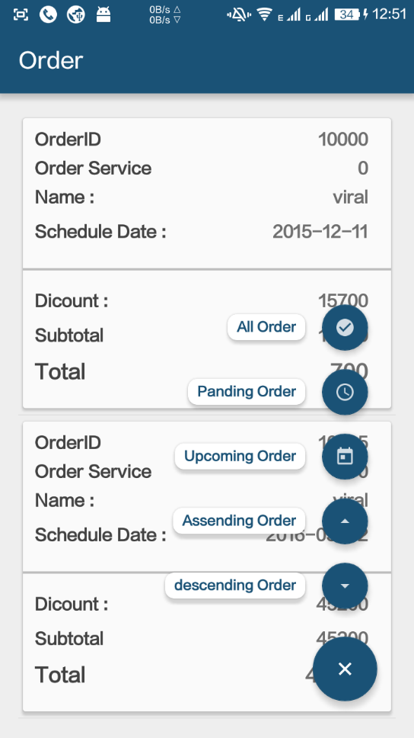
Order

Slide 31
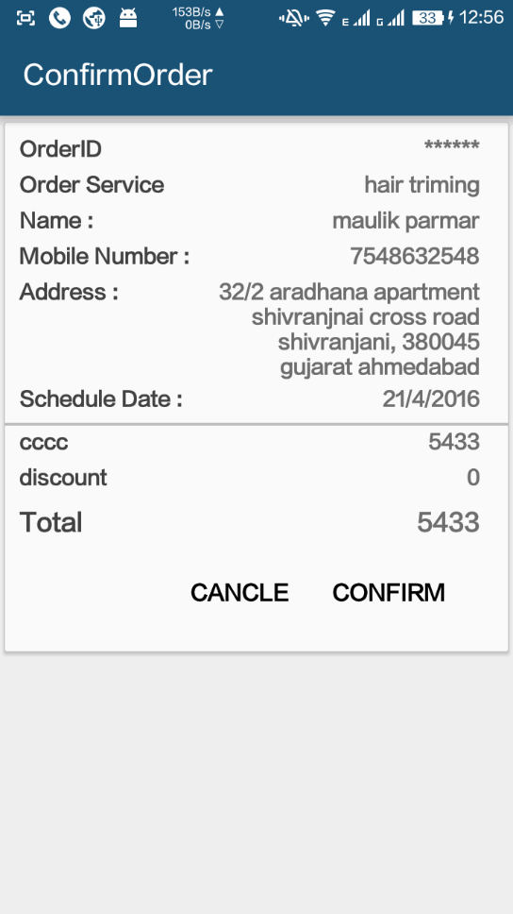
Confirm Order

Slide 32
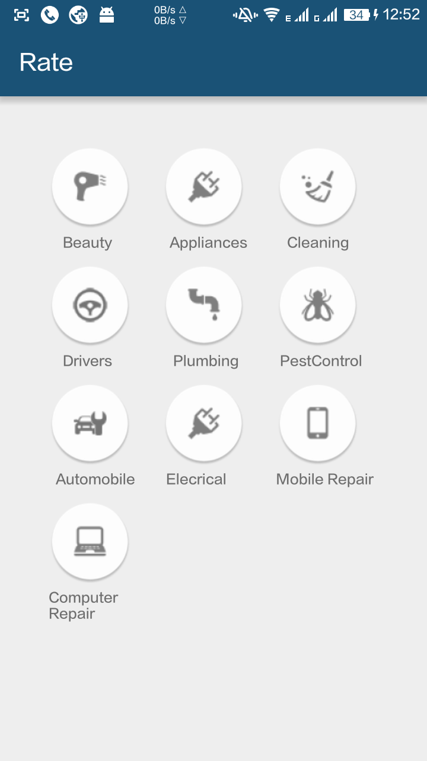
Rate Card

Slide 33
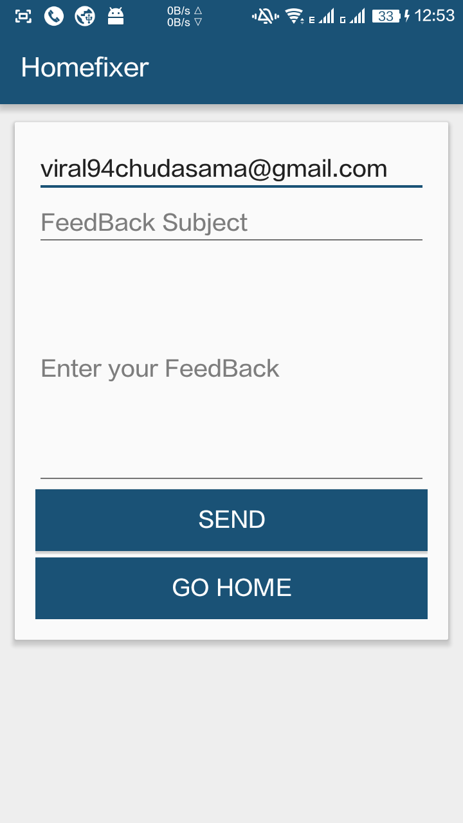
Feedback

Slide 34
Limitation
Only works on android devices & minimum 4.4.4 android version is required.
Require Internet connection.

Slide 35
Future Enhancement
In future we will include more home related services.
In future we could have our own email domain for better communication and contact.

Slide 36
Conclusion
Thanks for giving us such a great opportunity and guidance for making an android application.
Any suggestion regarding this application would be heartily welcomed.

Slide 37
Thank You ☺

